Slide 1
I am using xdk&phonegap build for android app creation
In phone gap build they say use latest cli 6.5

Slide 2
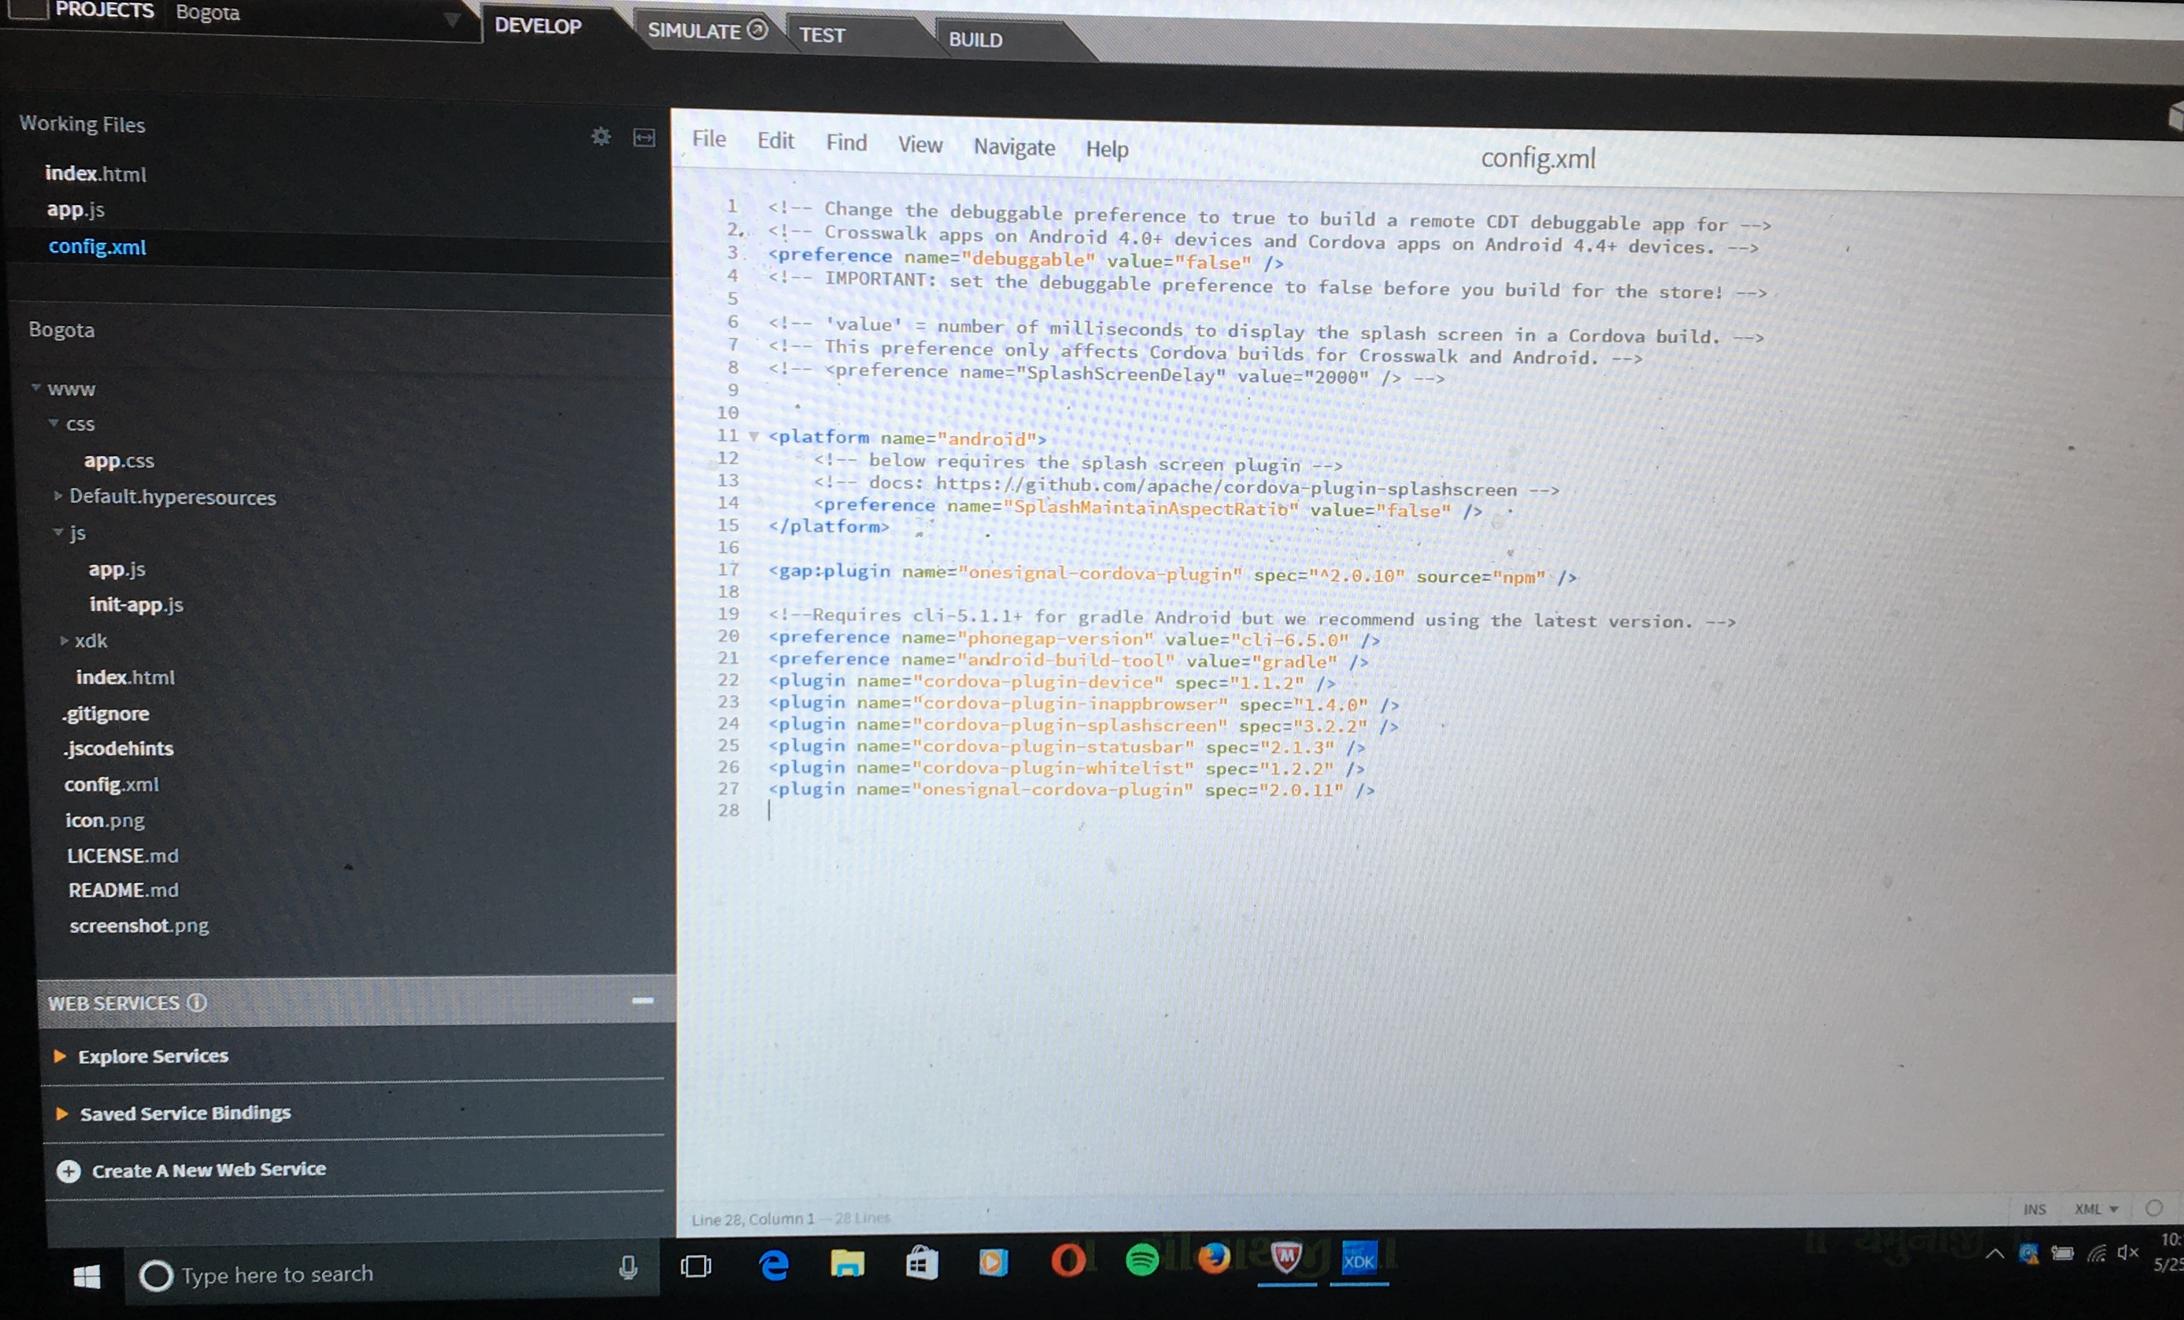
My config.xml converted fromxdk
I change value to 6.2.0 or 6.5.0 or 6.4.0
<preference name = “phone gap version” value=“cli-6.5.0”/>

Slide 3
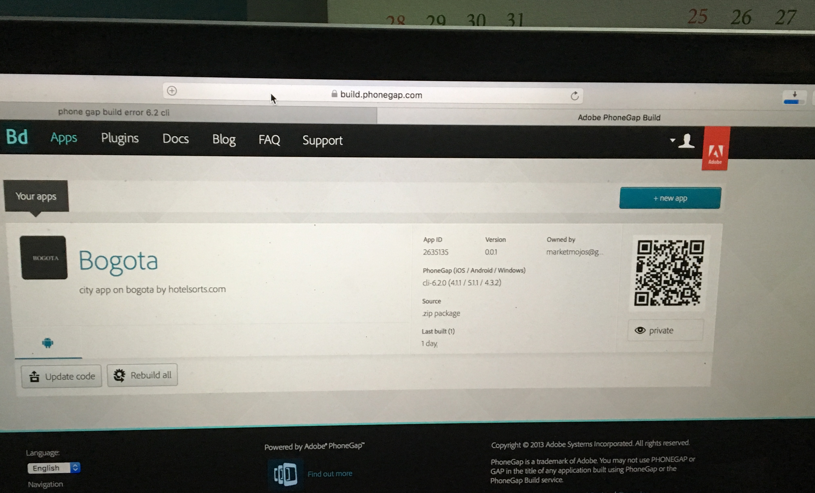

This is when i upload zip file created by xdk
i get same cli 6.2.0

Slide 4
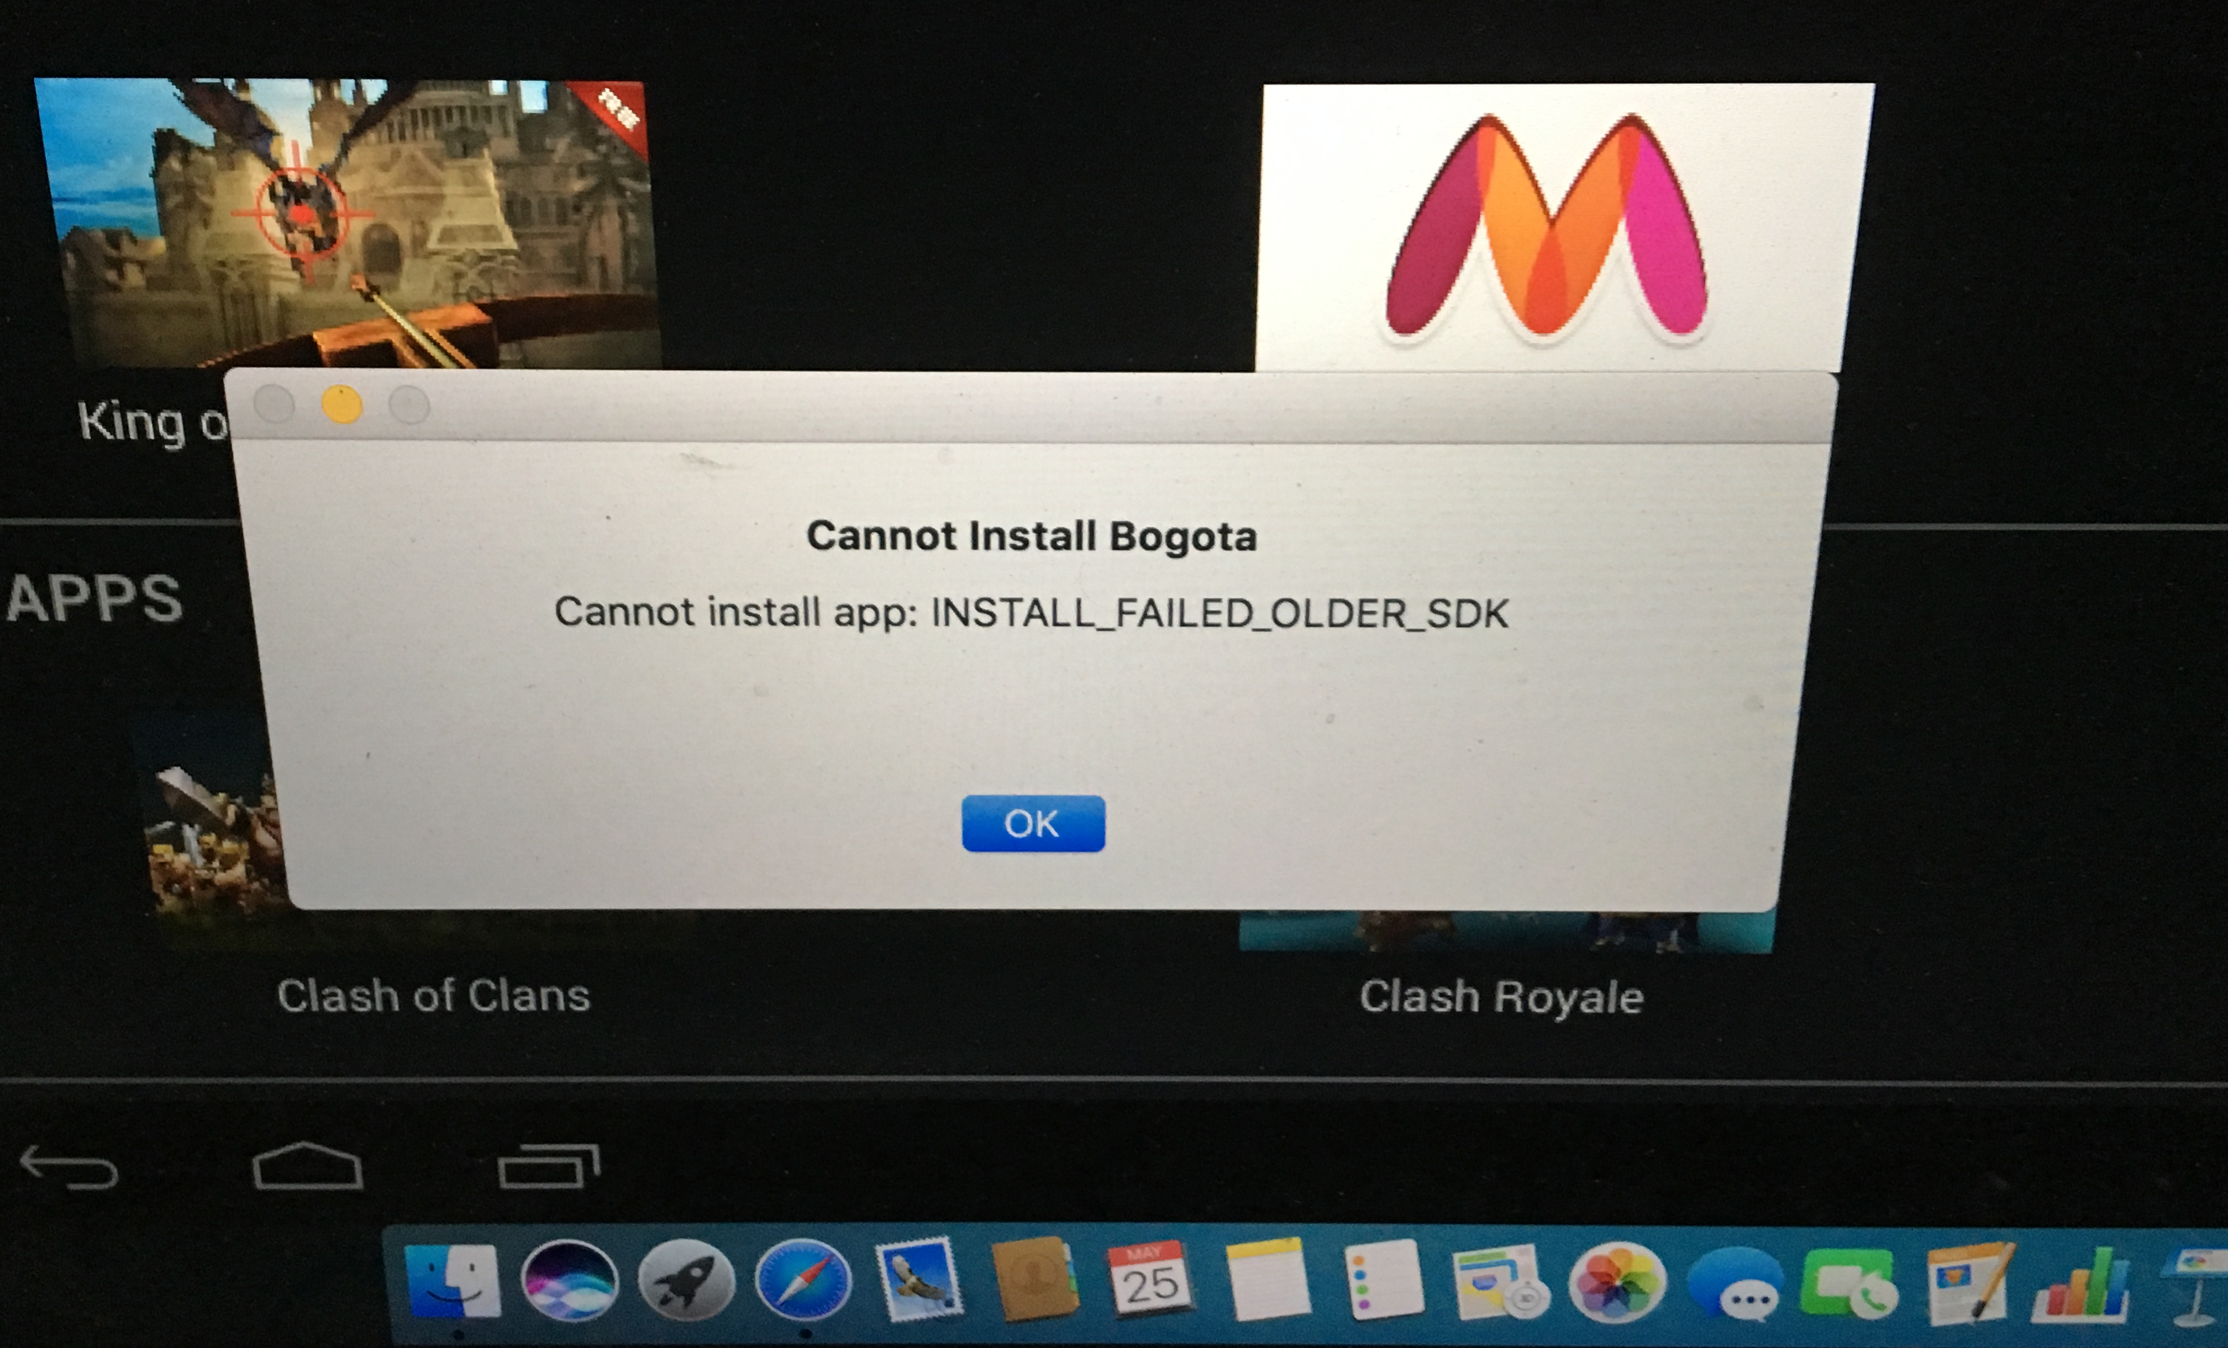
once debug app/release app is made by phone gap build i test in both blue stack and android phone
i get same answer.

